Slide 1
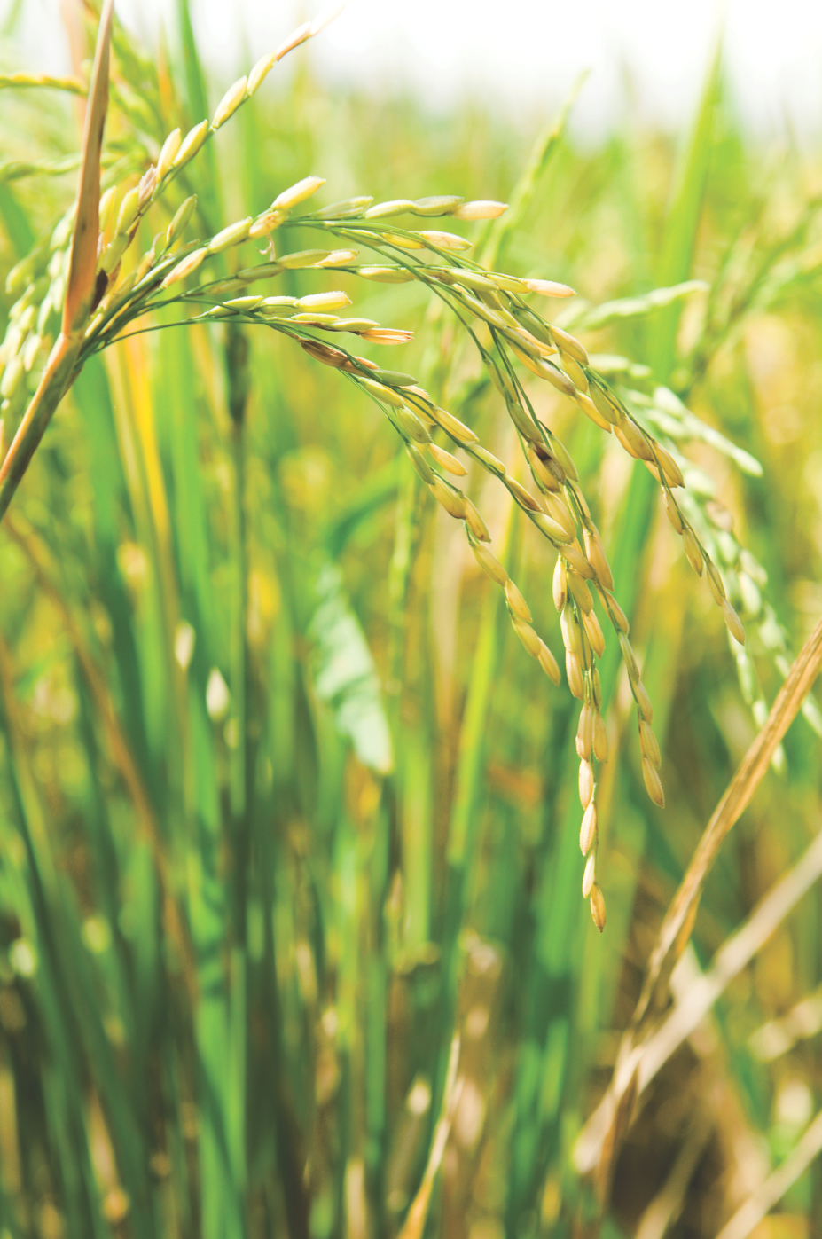
WHAT IS RICE?
History & Production

Slide 2
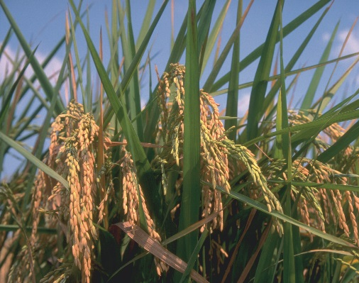
WHAT IS RICE?
The seed of a semi-aquatic grass that thrives in warm and sub-tropical climates.
Botanically classified as Oryza sativa.
Grown in many countries around the world, including the U.S.
Staple food for more than half of the world’s population.

Slide 3
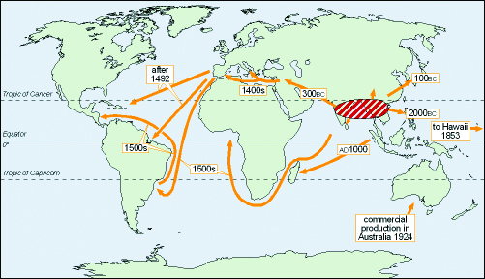
U.S. RICE – A BRIEF HISTORY
Originally cultivated in 2000 BC in China and India sub-continent.
Gradually moved to Southeast Asia, Persia (Middle East), Europe, Africa and then America.

Slide 4
U.S. RICE – A BRIEF HISTORY
Arrived in North America likely from a ship coming from Madagascar that sailed into harbor in South Carolina after being damaged.
Late 1680s
It is believed that in return for helping repair the ship, the captain gave colonists rice from the cargo; it was planted and became known as “Carolina Gold” and considered a major crop by 1700.
1700
Following the Civil War, rice production in the Carolinas and Georgia ended due to hurricane and economic conditions, so production moved westward to current day rice-growing states.
Late 1860s

Slide 5
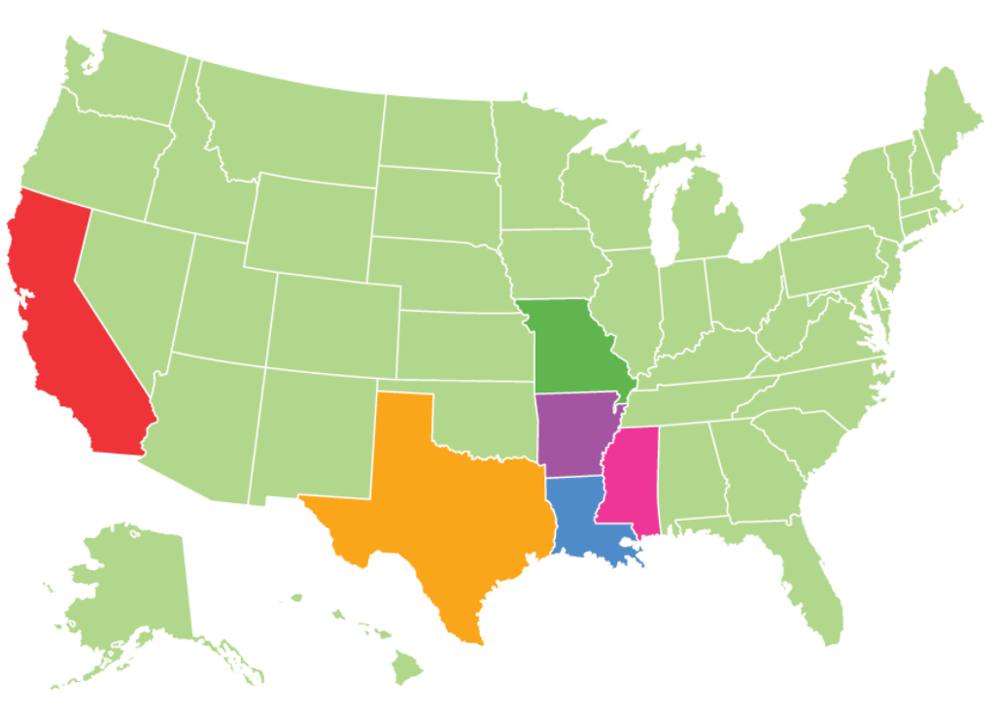
RICE PRODUCTION IN THE U.S.
About 18 billion pounds of rice are grown annually by farmers in Arkansas, California, Louisiana, Mississippi, Missouri, and Texas.
The Mississippi delta is largest rice-producing region in the U.S.
Arkansas accounts for nearly 50% of total U.S. rice acreage, growing long & medium grain.
California’s Sacramento Valley grows short, medium grain, and specialty varieties.

Slide 6
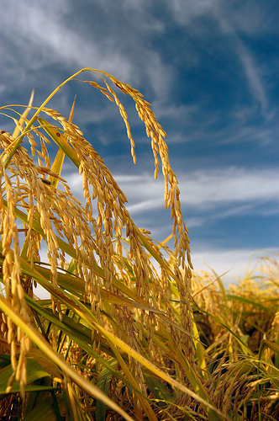
RICE PRODUCTION: 5-Year average
State | Harvested Acres (5-year Average) | Yield (lbs./acre) | Production (1,000 cwt.)*
Arkansas | 1,274,800 | 7,342 | 92,279
California | 501,600 | 8,490 | 43,367
Louisiana | 426,000 | 6,824 | 28,768
Mississippi | 156,200 | 7,196 | 10,782
Missouri | 177,200 | 6,872 | 11,680
Texas | 149,600 | 7,512 | 11,002
US Total | 2,685,400 | 7,454 | 197,878
*cwt is the standard industry measurement for “hundred weight,” or 100 lbs.
Source: USDA Rice Yearbook, 2016

Slide 7
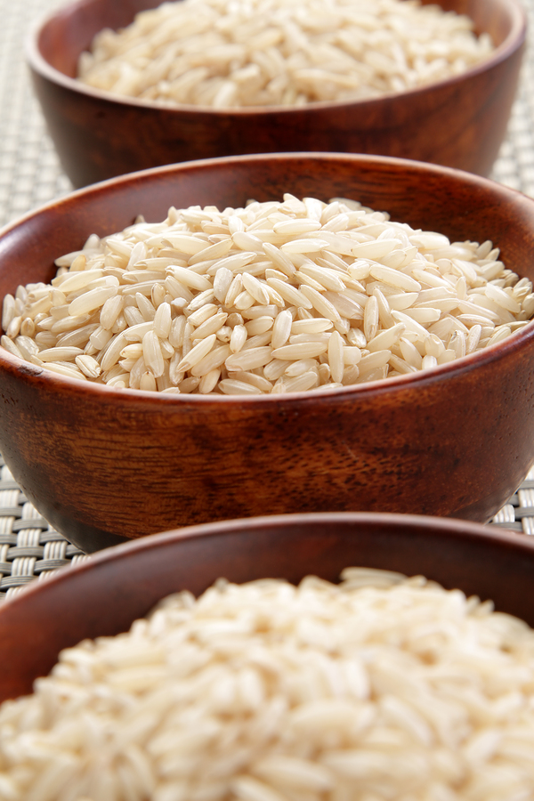
U.S. RICE PRODUCTION
Cultivation & Milling

Slide 8
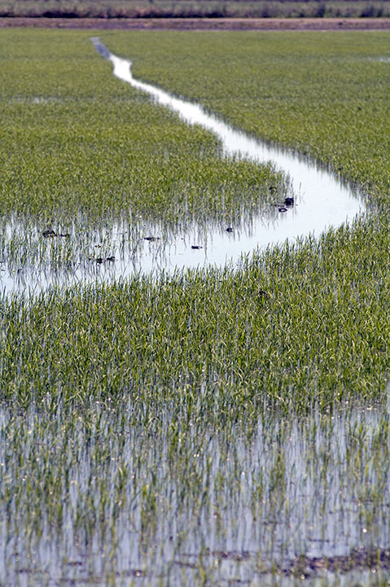
Cultivation: flooding
Rice cultivated differently than other grains as it requires controlled flooding and draining of the land.
In some countries flooding occurs naturally
Flooding provides moisture, reduces weeds and controls pests.
Draining ensures rice grains dry in time for harvesting.

Slide 9
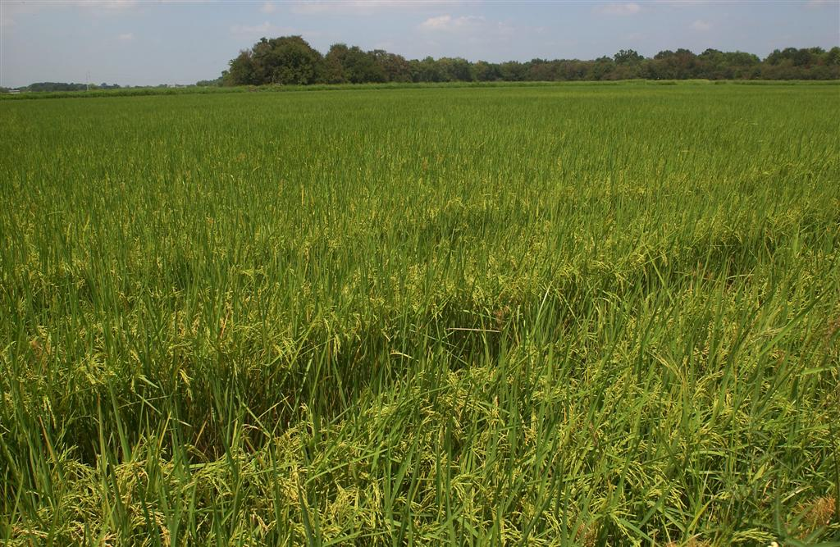
Cultivation: irrigation
Field manually flooded to depth of 2-3 inches.
Rice grains may be scattered over water or young rice plants can be planted.
Modern farmers use airplanes to spread seeds.
Takes 3-6 months for rice to reach maturity.
When grain reaches 18% to 23% moisture content, rice is harvested.

Slide 10
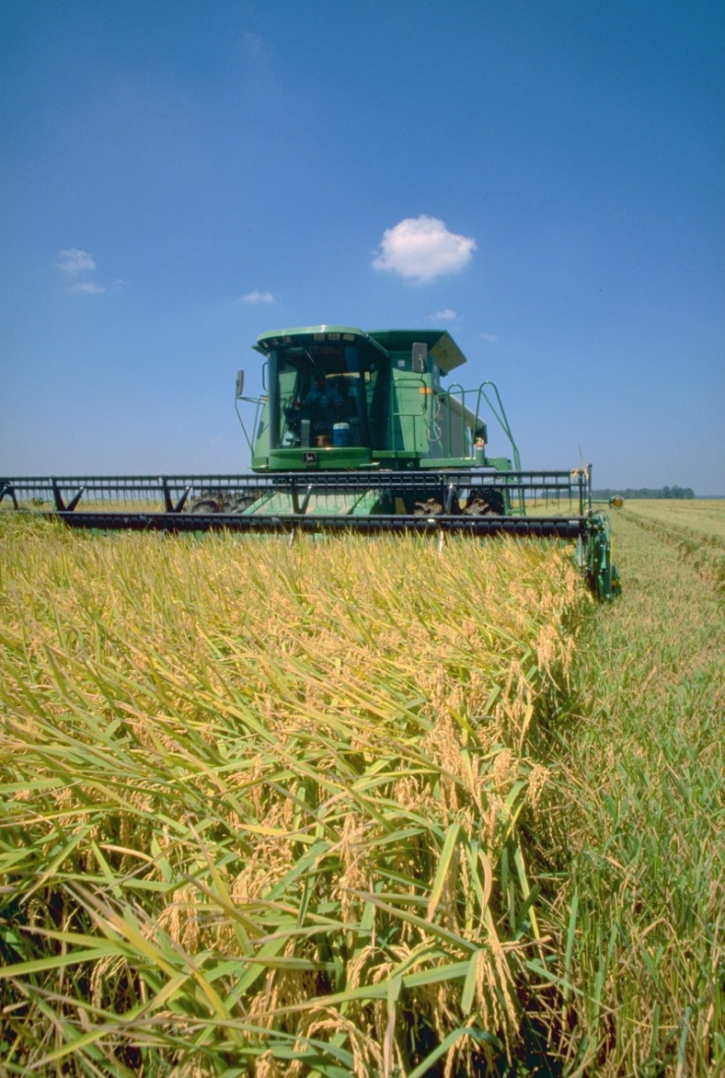
Cultivation: rice harvest
After fields are drained, rice grains separated from stalks.
Harvested rice kernels were traditionally dried in the sun; modern rice farms use forced air blowers.
Dried rice (also called rough, paddy or cargo rice) will have 12% to 14% moisture content before milling.

Slide 11
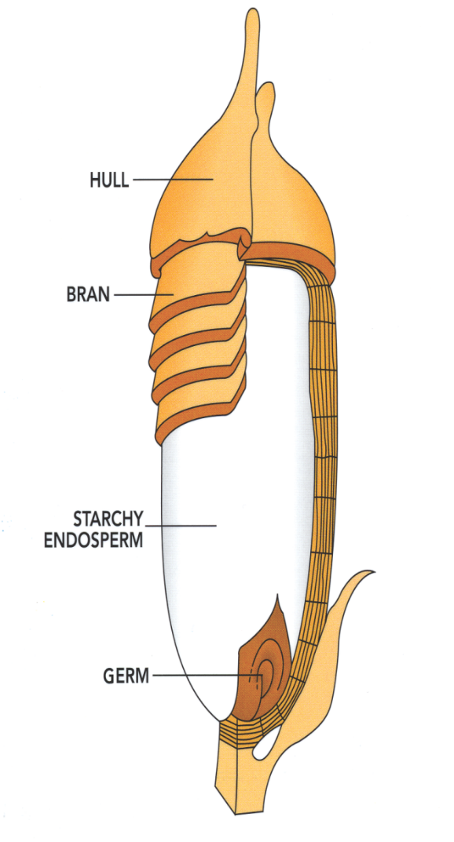
Milling: anatomy of a rice grain
Milling transforms paddy rice into food consumable by humans.
Four major parts:
Hull – Fibrous indigestible shell
Bran – Outer layer of dehulled rice kernel
Endosperm – Large interior, containing most nutrients
Germ – Embryo of rice kernel containing most of the oil

Slide 12
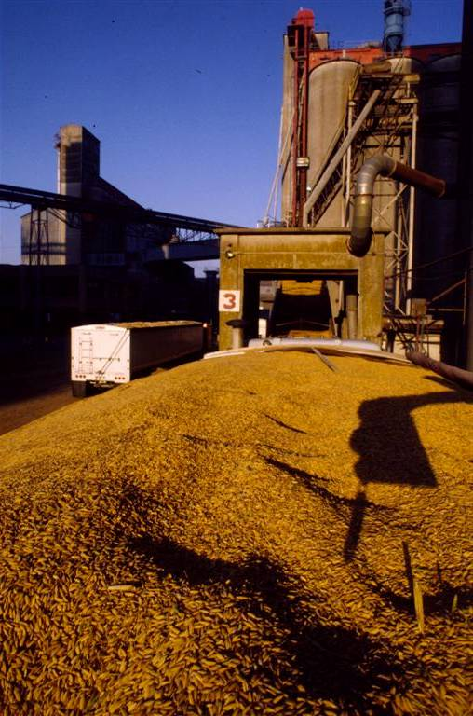
Milling steps
Hull removed by machines (“shellers”), resulting in whole grain rice.
Bran and germ removed by machines that rub the grains together, resulting in white rice.
Both brown and white rice sorted to remove any broken rice kernels.
In the U.S., most white rice is enriched with a thin coating of nutrients: thiamin, niacin, iron, and fortified with folic acid.

Slide 13
Rice milling overview
Types of Rice by Milling | Degree of Milling | Description
Paddy Rice | None | The whole rice grain after harvest before it is milled. Indigestible by humans, but may be used for animal feed.
Whole Grain Rice (such as Brown, Red or Black Rice) | Hull (husk) removed, with bran and germ intact | 100% whole grain rice takes on the natural color of the bran; has a chewy texture and nutty flavor; contains vitamins, minerals, fiber, antioxidants and phytonutrients.
White Rice | Hull, bran and germ removed | A nutritious, complex carbohydrate and the predominant form of rice consumed around the world. White to off-white in color and has a mild flavor and aroma.

Slide 14
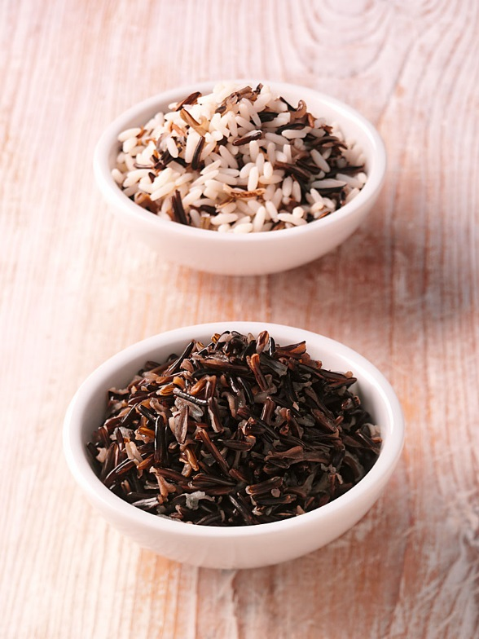
Wild rice
Wild Rice is an aquatic grass species native to North America.
It is not related to the rice species Oryza sativa, so it is not technically rice.
In the U.S., cultivated wild rice is grown in Minnesota and California.
Wild rice is a whole grain and an important ingredient in rice blends.

Slide 15
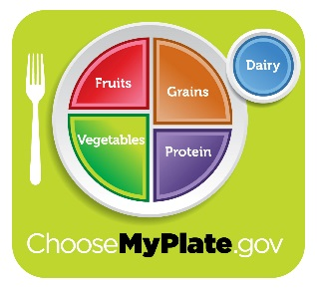
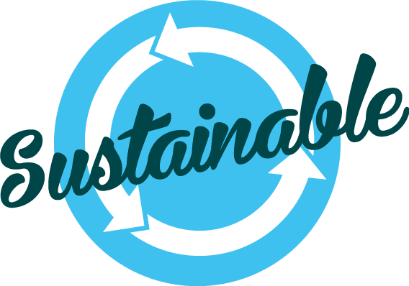
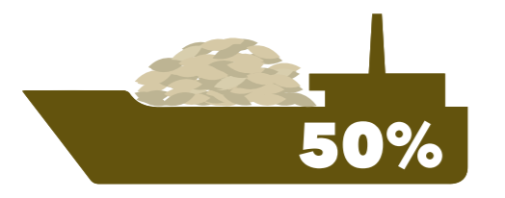
U.s. rice facts
The U.S. rice industry is recognized as an innovative, technologically advanced, conservation-friendly, and dependable supplier of high-quality rice, both in the U.S. and around the world.
More than 80% of rice consumed in the U.S. is grown by American farmers.
Whole grain rice & enriched white rice are included in the U.S. Dietary Guidelines for Americans.
Rice fields create critical wetland habitat for birds, mammals, and reptiles.
The U.S. is the 4th largest rice exporter, sending 50% of the crop to 110+ countries.
The Grown in the USA logo identifies rice produced in the U.S.

Slide 16
USA Rice
2101 Wilson Boulevard Suite 610
Arlington, VA 22201
703-236-2300
www.thinkrice.com

