Slide 1
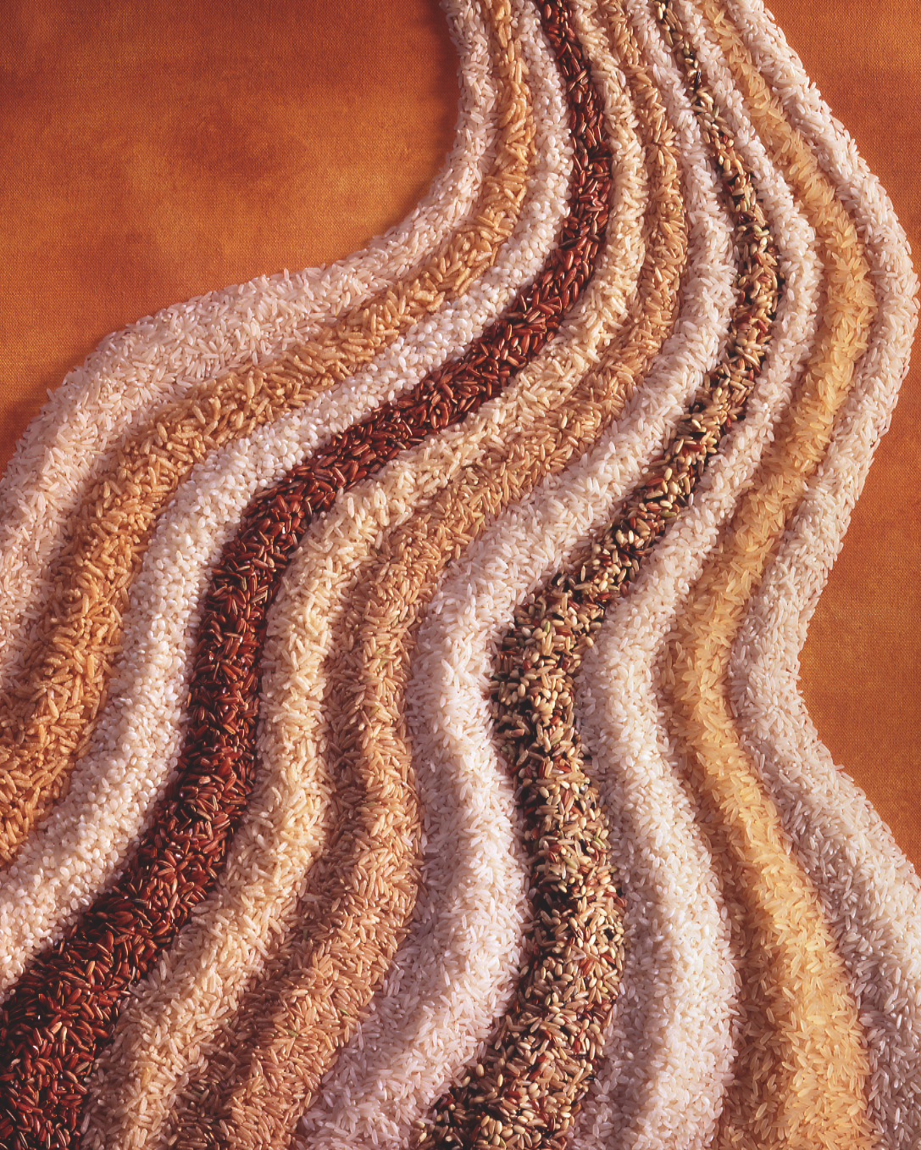
ALL ABOUT RICE
Science, Types, & Nutrition

Slide 2
RICE CLASSIFICATION
Categorized by:
Degree of Milling
Kernel Size
Starch Content
Flavor

Slide 3
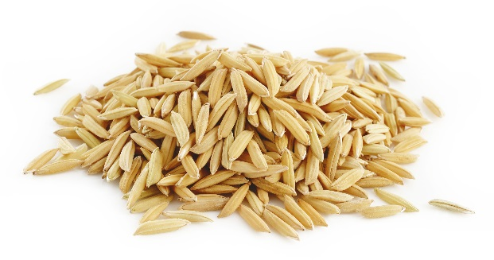
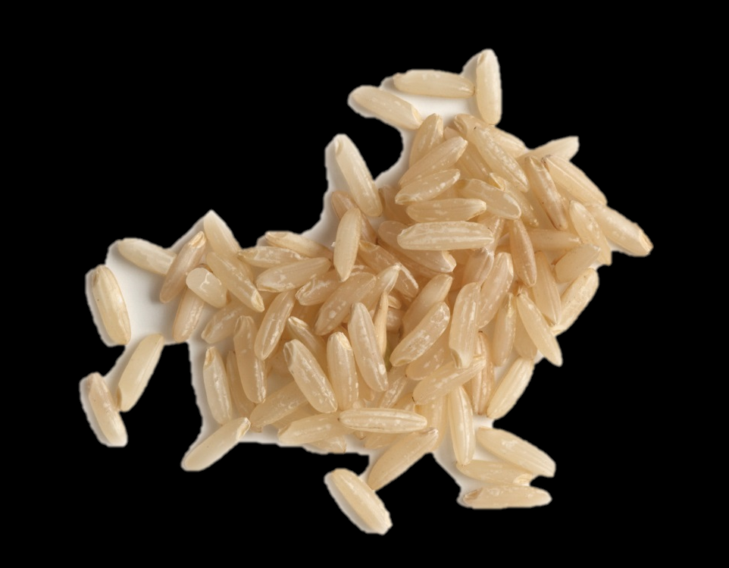
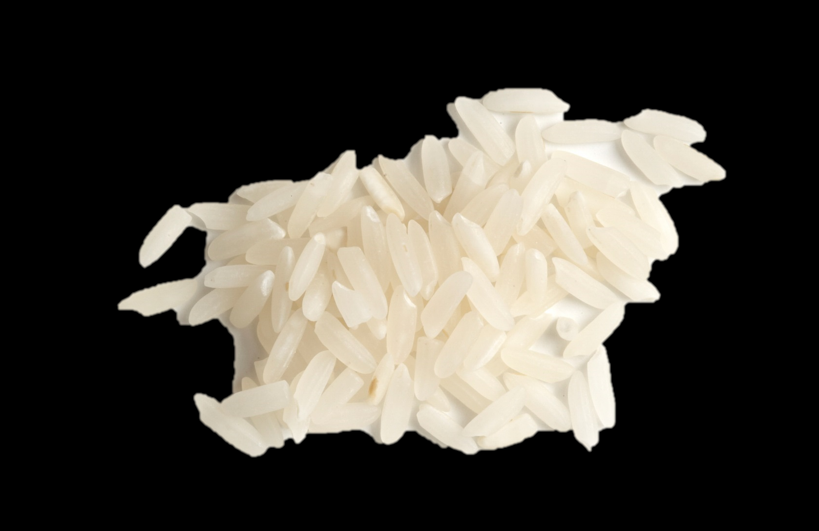
RICE CLASSIFICATION by Degree of Milling
Paddy Rice or Rough Rice is completely unprocessed. It includes the hull and is indigestible
Whole Grain (Brown) Rice has the hull removed, leaving the bran layer and germ intact.
White Rice is the endosperm of the kernel with the hull, bran and germ removed.

Slide 4
RICE CLASSIFICATION by Degree of Milling
Paddy Rice or Rough Rice is completely unprocessed. It includes the hull and is indigestible.
Whole Grain (Brown) Rice has the hull removed, leaving the bran layer and germ intact.
White Rice is the endosperm of the kernel with the hull, bran, and germ removed.

Slide 5
RICE CLASSIFICATION by Kernel Size
Kernel Size | Rice Grain Dimensions | Examples | Description of Cooked Rice | Usage Examples
Long Grain | 3 to 4 times as long as it is wide | Long grain brown or white Della U.S. basmati U.S. aromatic red U.S. jasmine | Fluffy separate grains While classified as long grain, jasmine rice’s characteristics resemble medium grain’s moist, clingy texture | Entrées Soups Pilafs Fried Rice Rice Bowls
Medium Grain | 2 to 3 times as long as it is wide | Medium grain brown or white Calrose Premium medium grain U.S. arborio Black japonica Mahogany japonica | Moist and slightly sticky | Sushi Risotto Paella
Short Grain | Short and almost round | Short grain brown or white Koshihikari Calmochi Akitakomachi | Soft, moist sticky | Desserts Rice Pudding

Slide 6
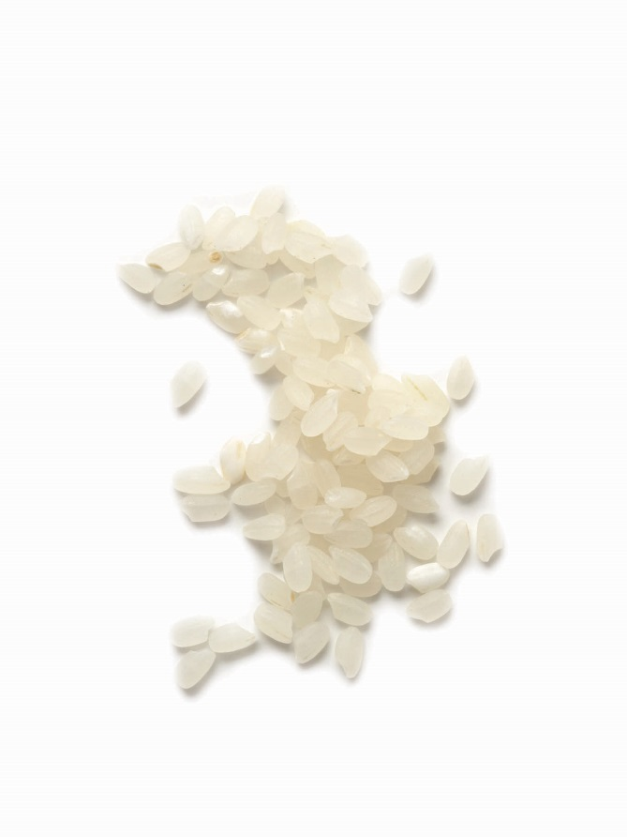
RICE CLASSIFICATION by Starch Content
Starch makes up most of a rice kernel. Rice is composed of two types of starch molecules:
Amylose
Makes rice firm and fluffy
Good for pilafs, entrees, salads
Amylopectin
Makes rice soft and sticky
Good for risotto, sushi, desserts

Slide 7
RICE CLASSIFICATION by Flavor
Aromatic Rice Type | Appearance | Flavor Description
U.S. jasmine | Long medium-thick grains | Popcorn, subtle floral
U.S. basmati | Long slender grains | Popcorn, toasted nuts
U.S. black and mahogany japonica | Medium-long grains, purple-black or dark brown color | Subtle sweet spiciness
U.S. aromatic red | Medium-long grains, mahogany-honey-red color | Sweet nuttiness

Slide 8
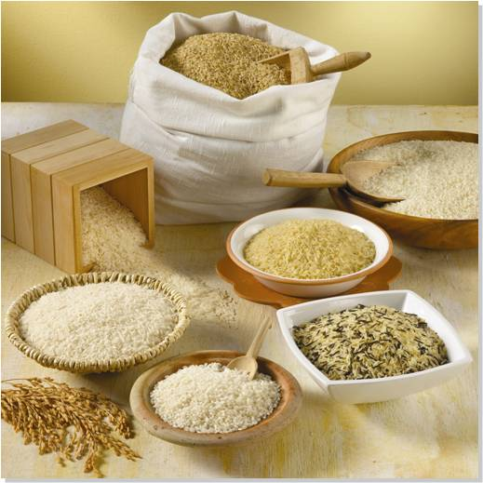
FORMS OF RICE by Milling Process
Regular-Milled Rice
Parboiled Rice
Precooked (Instant) Rice
Individual Quick Frozen (IQF) Rice
Ready-to-Serve Rice
Seasoned Rice Mixes

Slide 9
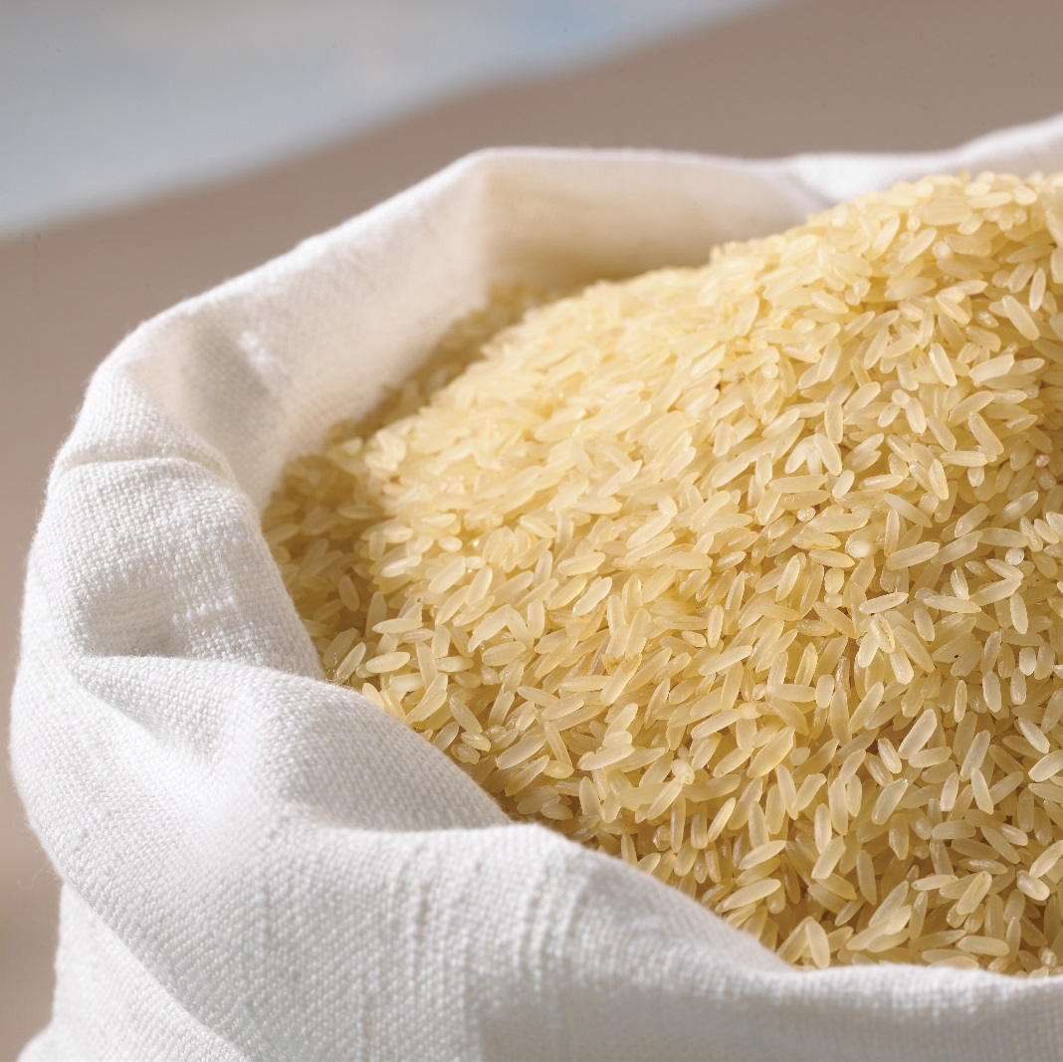
WHAT IS PARBOILED RICE?
Short for partially boiled because it is paddy rice steamed under pressure in the hull.
Do not confuse it with precooked/instant; parboiled rice must be fully cooked before serving.
Benefits include rice that is firmer, fluffier and more separate grains; holds well on steamtables for longer periods of time.
May have a pale yellow color as pigments and nutrients are transferred into the endosperm when grains are pressure steamed.

Slide 10
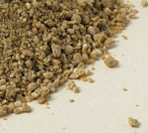
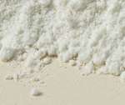
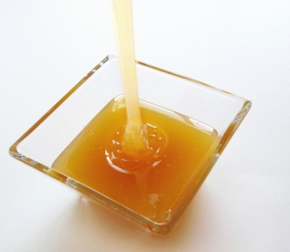
RICE CO-PRODUCTS by Milling Process
Rice Flour
Ideal for gluten-free products
Good for dusting dough surfaces
Makes crispier coatings – does not readily absorb water
Rice Bran
Good source of dietary fiber
Rich in antioxidants – reduces risk of heart disease, certain cancers, & type II diabetes
Rice Syrup
Mild flavored sweet syrup
Substitute for sugar, honey, corn syrup, molasses, or maple syrup in recipes
Rice Bran Oil
Extracted from rice bran
Nut-like flavor, good shelf stability and ideal for frying
May help reduce cholesterol

Slide 11
TOP 10 BENEFITS OF RICE IN FOODSERVICE
1. Global | Rice is a staple ingredient in American and ethnic cuisines
2. Versatile | Abundance of rice types to meet any culinary need
3. Flavor Carrier | Mild, neutral flavor is an ideal carrier for other ingredients, sauces and seasonings
4. Nutritious | Naturally wholesome and combines with other healthy foods
5. Low Cost and Profitable | Less than 10 cents per serving, rice offsets the costs of more expensive proteins; also revitalizes leftovers
6. Easy to Prepare | Can be prepared quickly and effectively; rice helps manage labor costs
7. Non-Perishable | Dry rice doesn’t require refrigeration or freezer space to store
8. Travels Well | Ideal for takeout; cooked rice holds, travels and reheats well
9. Multiple Types | Various forms fit a wide variety of foodservice uses
10. Convenient | Available in blends and seasoned mixes for consistent results and as a “shortcut” to final dishes

Slide 12
RICE IS NUTRITIOUS
Sodium and cholesterol-free.
Approximately 100 calories per half-cup serving.
Nutrient dense; contributing over 15 vitamins and minerals, including B-vitamins, iron, zinc, thiamin and folic acid.
Only a trace of fat; no saturated fat or trans fats.
Comprised of complex carbohydrates that are digested slowly and provide fuel for the body’s physical activity.
Consumers who eat rice have diets closer to the recommended U.S. Dietary Guidelines for Americans.

Slide 13
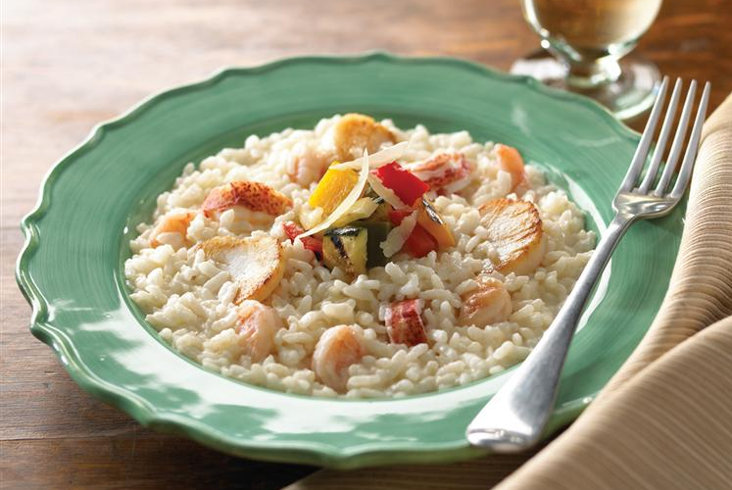
RICE IS GLUTEN-FREE
Rice is the least allergenic of all grains and naturally gluten-free.
Gluten intolerance (Celiac disease) affects over 3 million Americans.
Celiac disease sufferers are unable to digest gluten, the protein found in grains including wheat, barley and rye.
Enriched white rice and brown rice are important staples in gluten-free diets, providing vitamins and minerals needed for good health.

Slide 14
WHOLE GRAIN RICE
Brown rice is 100% whole grain*.
Whole grain brown rice provides fiber, phytonutrients and antioxidants.
Brown rice bears the 100% Whole Grain Stamp from The Whole Grains Council, a non-profit consumer advocacy group.
U.S. Dietary Guidelines recommend 3 or more servings of whole grains per day.
* Other whole grain rice includes: black japonica, aromatic red and any other rice that has the bran layer intact

Slide 15
USA Rice
2101 Wilson Boulevard, Suite 610
Arlington, VA 22201
703-236-2300
www.thinkrice.com

