Slide 1
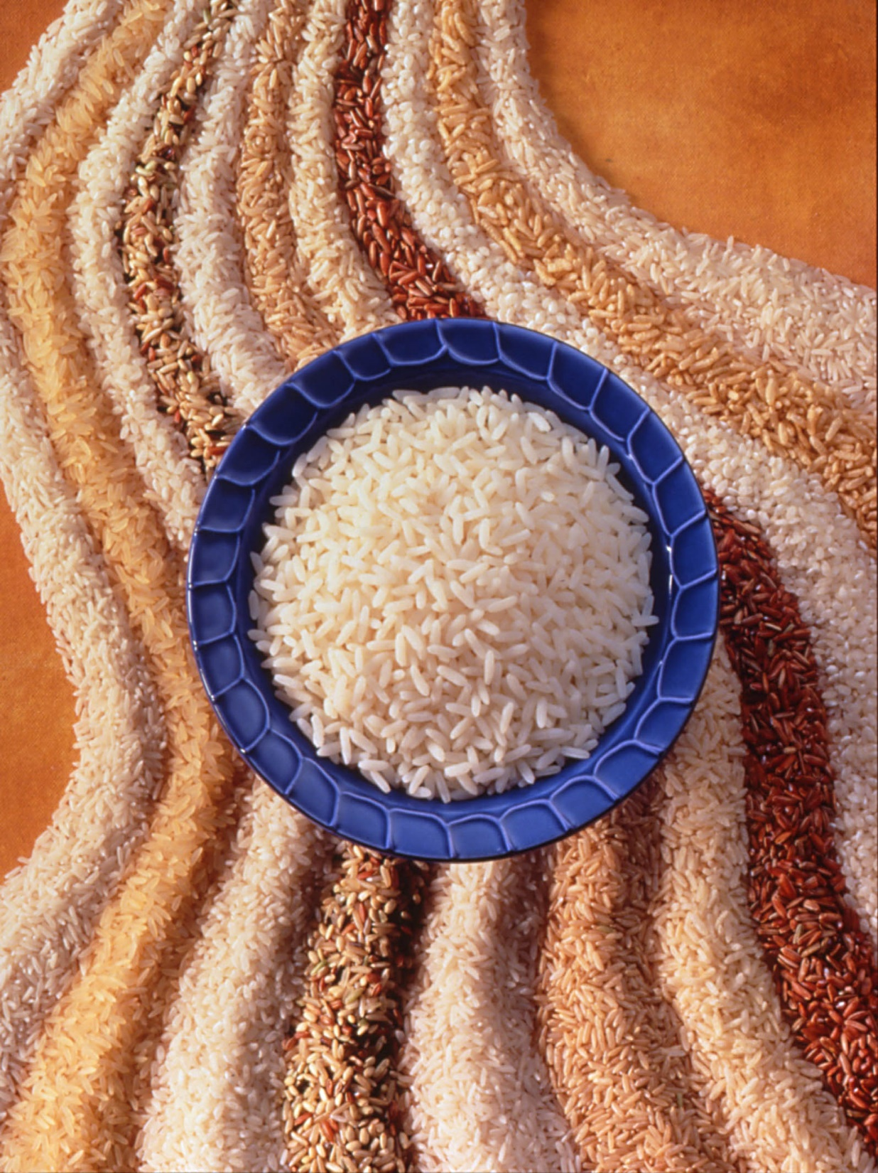
Understanding Rice Varieties, Types, and Forms

Slide 2
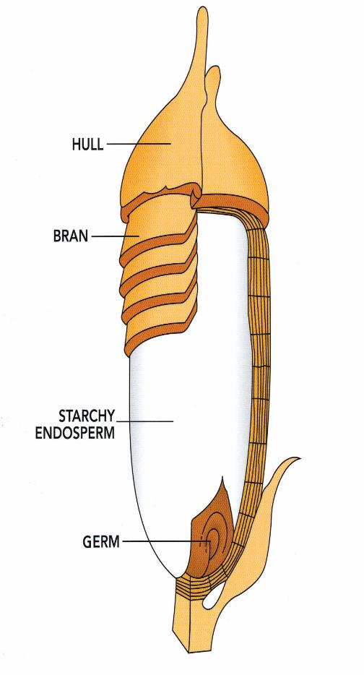
What is Rice?
The seed of a semi-aquatic grass that thrives in warm and sub-tropical climates and officially classified as Oryza Sativa
Grain Anatomy
Grain is enclosed with in a tough outer hull/husk
Under the hull are the bran and germ. Rice at this stage is 100% whole grain
Remove the bran and germ and what remains is the endosperm which is white rice, the most consumed rice throughout the world
All U.S.-grown rice is gluten-free, GMO-free, sodium-free, cholesterol-free, and virtually fat-free

Slide 3
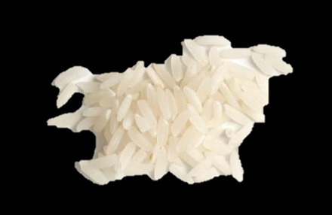
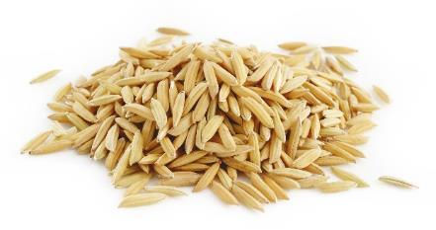
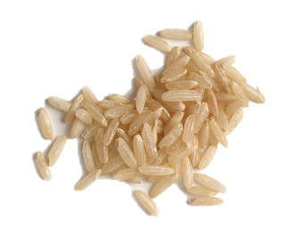
Rice Milling
After harvest, the collected rough rice is dried to a certain level prior to milling. The final step of rice production is milling, an intricate process that U.S. mills have perfected.
Harvested rough rice is cleaned and passed through sheller machines that remove the inedible hulls and yields brown rice.
Brown rice can then be further milled to remove the outside bran layer and produce white rice.
Specific to the U.S.-the white rice is then enriched with a coating of vitamins to replace nutrients lost during the milling process
(Rough Rice)
(Brown Rice)
(White Rice)

Slide 4
Types of Rice by Milling | Degree of Milling | Rice Description
Paddy Rice | None | Paddy/Rough Rice collected from harvest before it is milled. Indigestible for humans, but usable for feed.
Whole Grain Rice (Brown, Red, Black Rice) | Hull (husk) removed with bran & germ intact | 100% whole grain rice; chewy texture and nutty flavor; contains vitamins, minerals, antioxidants, and phytonutrients.
White Rice | Hull, bran, and germ removed | A nutritious complex carbohydrate that is the most popular rice consumed globally.

Slide 5
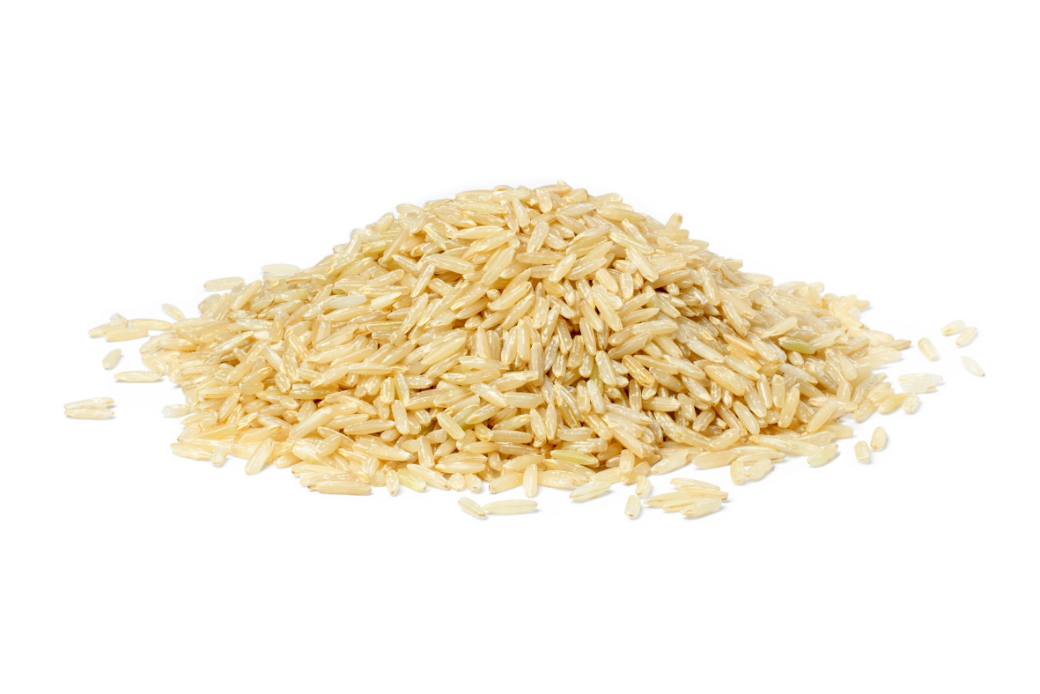
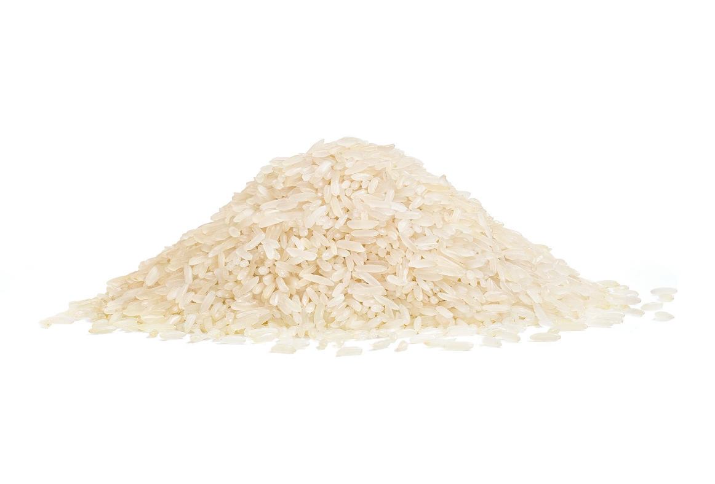
Brown Vs White Rice
Brown (Whole Grain) Rice | White (Enriched) Rice
Brown rice is a whole grain containing the bran, germ, and endosperm Has a slightly earthy, nutty flavor and chewy texture Known for powerful nutritional properties Helps maintain healthy diets, contributes to positive health outcomes, and reduces risk of disease Longer cook times and shorter shelf life | Milled to remove bran and germ layer, leaving just the endosperm Enriched with key vitamins and minerals Nutritious complex carbohydrate Shorter cook times and almost indefinite shelf life Accounts for the majority of U.S. rice production Most consumed rice worldwide

Slide 6
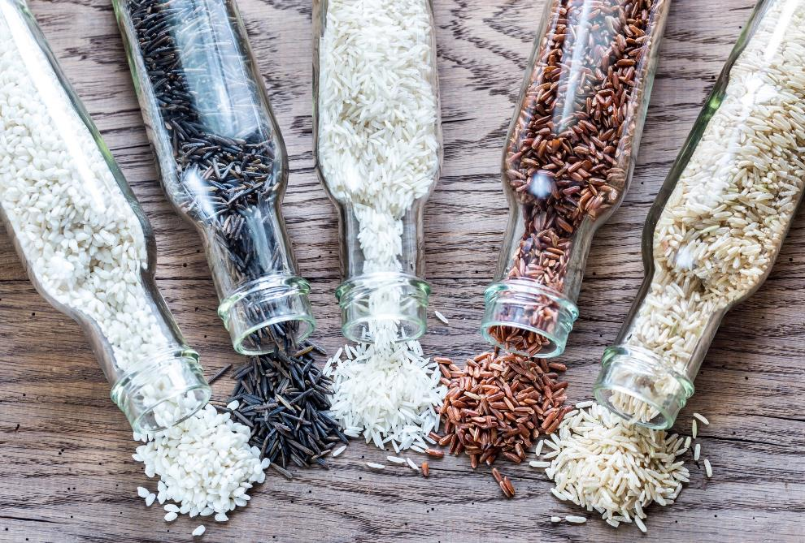
U.S.-Grown Rice Varieties
The domestic rice industry produces all rice varieties from well-known white long grain to aromatics to harder to find specialty rice.
Every Rice is Categorized by:
Degree of Milling: Rough, Whole Grain, White Rice
Kernel Size: Short, Medium, and Long Grain
Starch Content: Amylose, Amylopectin
Flavor: Popcorn, Sweet, Nutty, Spicy

Slide 7
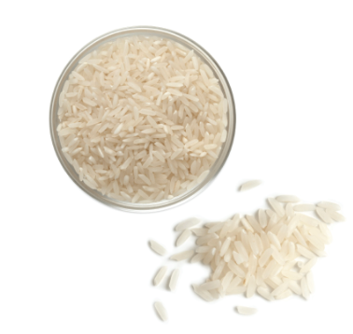
Long Grain Rice
Most Common and Plentiful Variety
Long, Slender Kernels with High Amylose Starch Content
Cooked Grains are Firm, Fluffy, and Separate
Ideal for Pilafs, Stir-Frys, Salad, Bowls, Handhelds, Soup, and Side Dishes

Slide 8
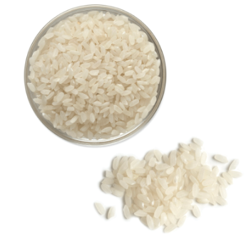
Medium Grain Rice
Shorter, Wider Kernels than Long Grain
Cooked Grains are Moist, Tender, Slightly Chewy, and Tend to Stick Together
Ideal for Dishes w/ Creamy Consistency: Paella, Risotto, Confections, Snacks

Slide 9
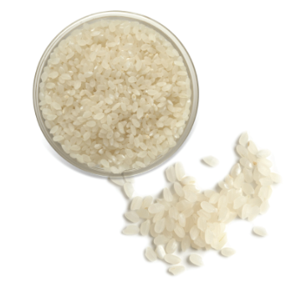
Short Grain Rice
Kernels are Short, Plump, and almost Round
Cooked Grains are Soft and Sticky
Ideal for Sushi, Puddings, Desserts, Sweet Rice Dishes, and Sake

Slide 10
Kernel Size | Rice Grain Dimensions | Examples | Description of Cooked Rice | Usage Examples
Long Grain | 3 to 4 times as long as it is wide | Brown or white long grain Della U.S. basmati U.S. aromatic red U.S. jasmine | Fluffy separate grains While classified as long grain, jasmine rice’s characteristics resemble medium grain’s moist, clingy texture | Entrées Pilafs Fried Rice Rice Bowls
Medium Grain | 2 to 3 times as long as it is wide | Brown or white medium grain Calrose Premium medium grain U.S. arborio Black japonica Mahogany japonica | Moist and slightly sticky | Soups Sushi Risotto Paella
Short Grain | Short and almost round | Brown or white short grain Koshihikari Calmochi Akitakomachi | Soft, moist sticky | Sushi Desserts Rice Pudding

Slide 11
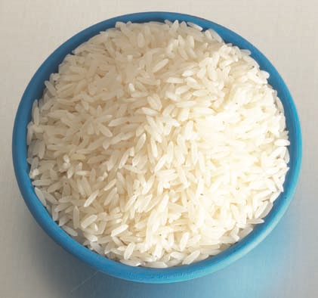
Jasmine Rice
Aromatic Long Grain Variety with Distinct Flavor and Popcorn Aroma
Cooked Grains are Soft, Moist, and Slightly Cling Together
Major Ingredient in Thai and Southeast Asian cuisines

Slide 12
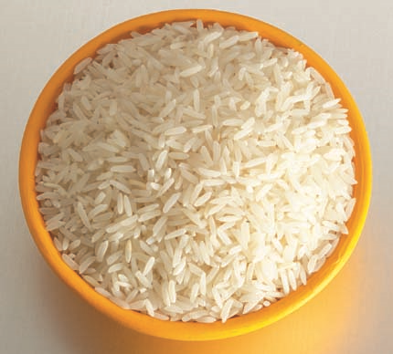
Basmati Rice
Long Grain Variety with Distinct Aroma and Savory, Nutty Flavor
Cooked Grains are Slightly Chewy and have a Fluffy Texture with Little Stickiness
Often used in Indian and Mediterranean cuisines and some Middle Eastern Dishes

Slide 13
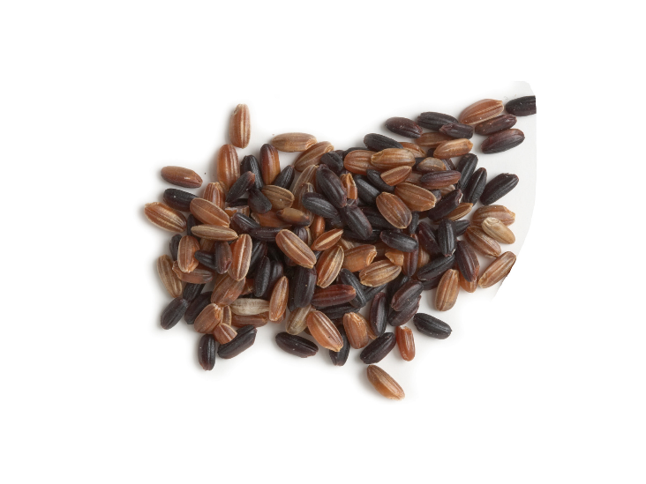
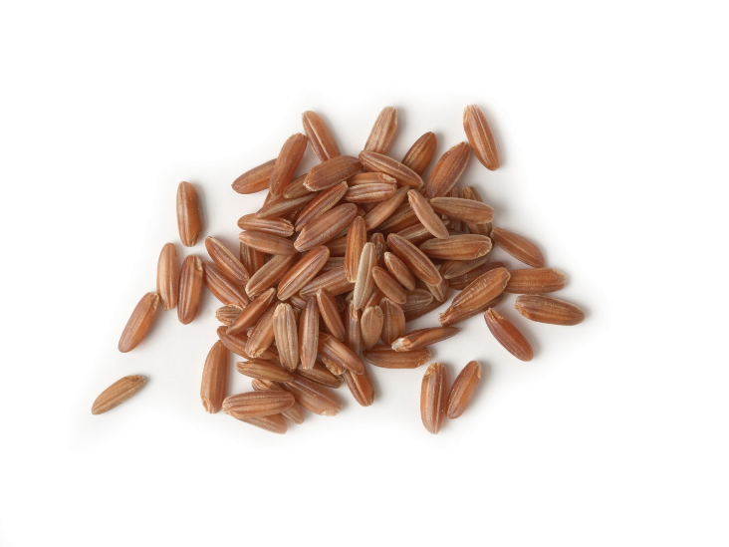
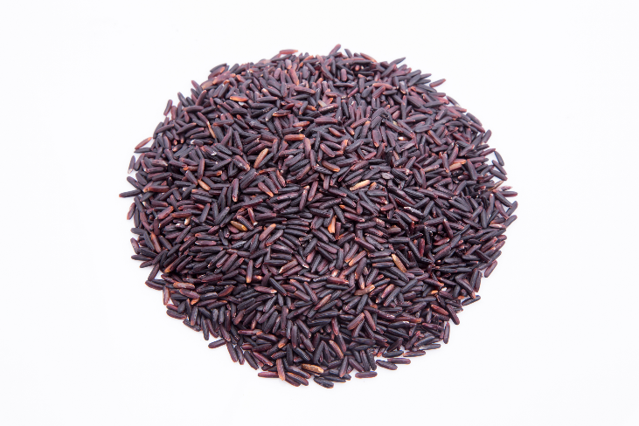
Other Aromatic Rice
Black Japonica Rice | Red Rice | Purple Rice
Medium Grain, 100% Whole Grain Cooked Grains are slightly chewy with subtle sweet spiciness and hearty texture Contains antioxidants and special phytonutrients | Long Grain, 100% Whole Grain Cooked Grains are slightly chewy and have a savory, nutty flavor Increased boost of antioxidants | Specialty Long Grain, 100% Whole Grain Cooked grains are a deep purple with a quick cook time Contains antioxidants and fiber

Slide 14
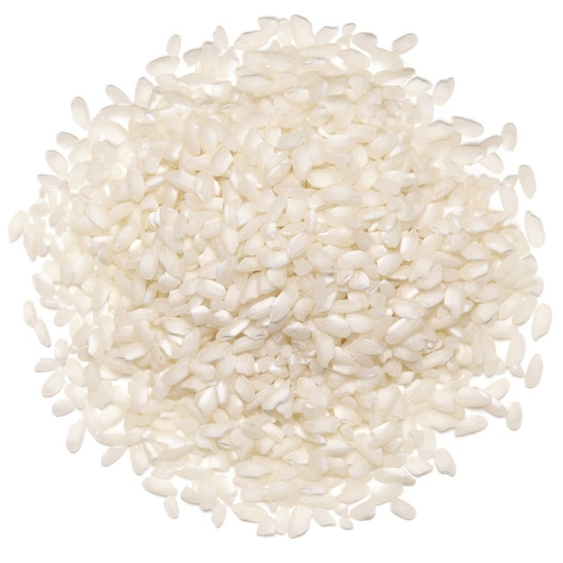
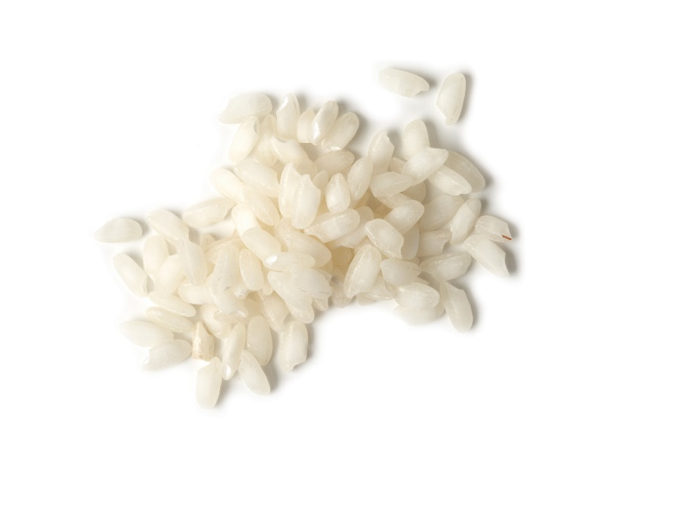
Calrose & Arborio Rice
Calrose | Arborio
Medium-grain rice grown in California Accounts for the majority of California’s rice production Very mild and pairs well with a range of flavors Cooked grains are soft and somewhat sticky, making it a good option for sides, stir-fries, and sushi | Medium grain rice with a characteristic white dot at the center of the plump grain. Contains a high level of amylopectin starch that is released during stirring and contributes to its creamy texture Higher protein content than other medium grains Primarily used in risotto, desserts, and dishes where creamy texture is welcome Has an exceptional ability to absorb flavors.

Slide 15
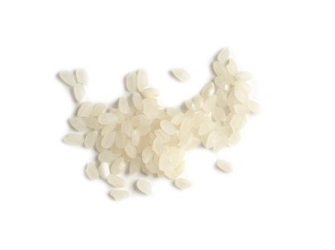
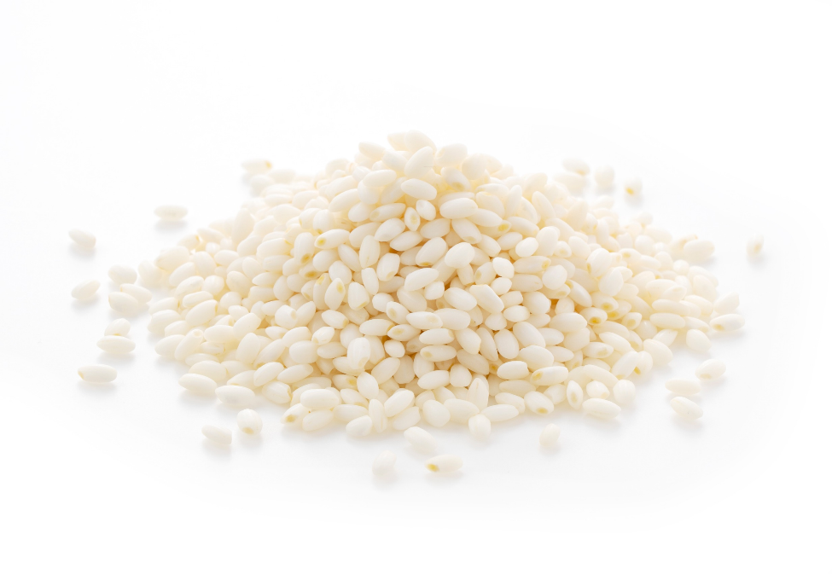
Sticky & Sushi Rice
Sticky Rice | Sushi Rice
Variety that’s also often labeled “sweet rice” or “glutinous rice.” Chalky white, short, plump grains Cooked grains are practically glued together when cooked due to starch content Ideal for sweet and savory dishes | More a preparation of rice than a rice variety Made by combining hot, cooked short or medium grain rice with sugar, salt, and vinegar Mixture is cooled, then used to make sushi Packages labeled “sushi rice” in retail, are undoubtedly short-grain white or brown rice

Slide 16
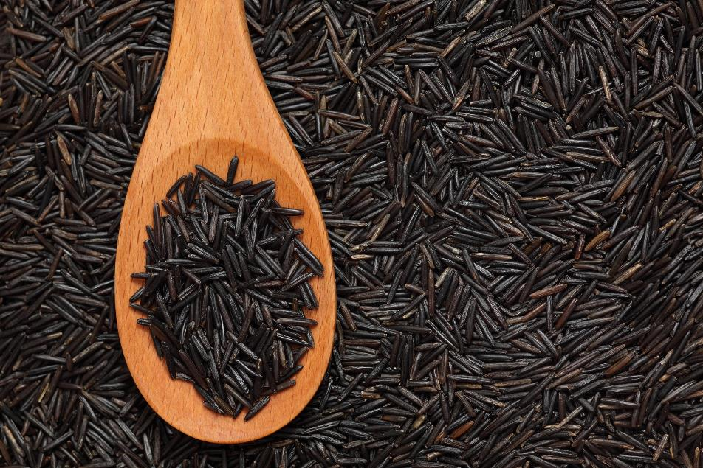
Wild Rice
Not a Rice, Semi-aquatic Grass Native to North America
Hearty and Nutrient-Rich
Cooked Grains Greatly Expand, Have Chewy Texture and Earthy Taste

Slide 17
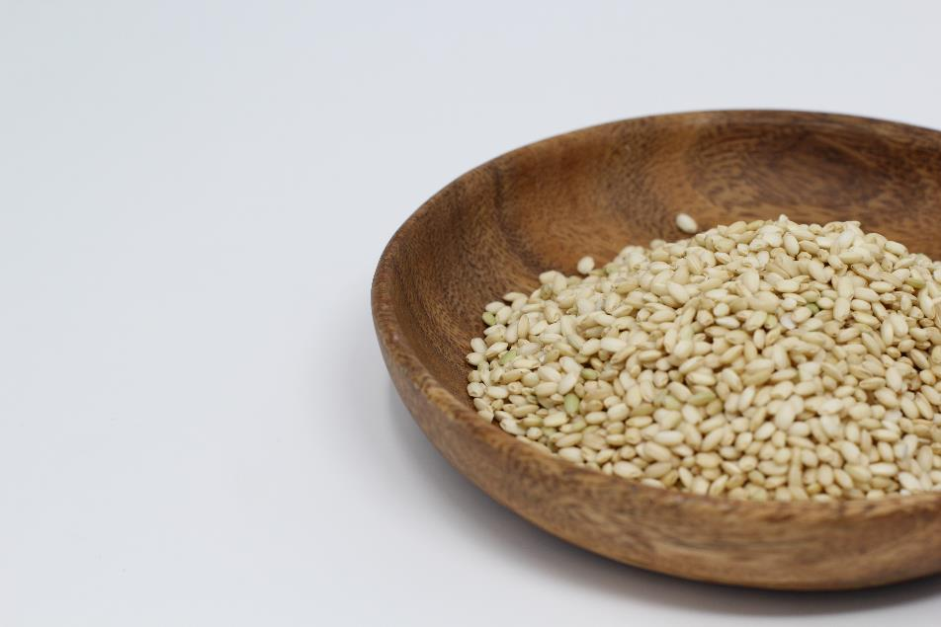
Sprouted Rice
Whole Grain Germinated Rice
Nutritional Powerhouse with High Levels of GABA Amino Acid
Increased Fiber, Vitamin E, Fiber, and lower Glycemic Index

Slide 18
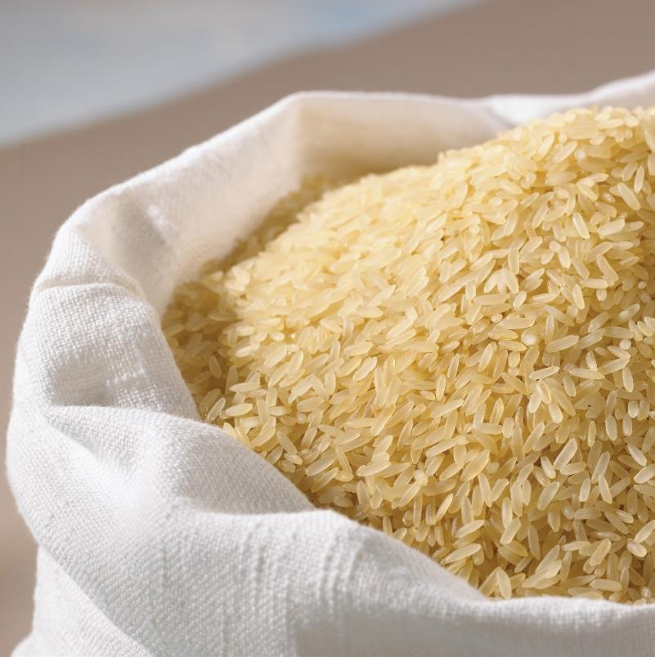
Parboiled Rice
Partially Boiled, Steam Pressured Rough Rice
Perfect for Foodservice with Long Hold Times and Shorter Cook Times
Firmer, Fluffier, More Separate Grains

Slide 19
Forms of Rice
Precooked Rice
Precooked rice, also called quick-cooking or instant rice, is white or brown rice that has been completely cooked and dehydrated. As a result, precooked rice only requires rehydration or brief cooking before serving.
Retort Rice
Retort or ready-to-heat rice is fully cooked rice that is packaged in pouches or cup containers and is ready to eat after brief heating.
Individually Quick-Frozen (IQF) Rice
Cooked rice grains are individually frozen before packaging to provide a free-flowing ingredient for use in frozen and prepared food products and for ease of use in foodservice operations.
Seasoned Rice Mixes
Regular milled, parboiled, or precooked rice containing pre-measured seasonings for ease of preparing a variety of flavored finished products, such as Spanish rice, wild rice pilaf, yellow rice, and more. Custom mixes are also available.

Slide 20
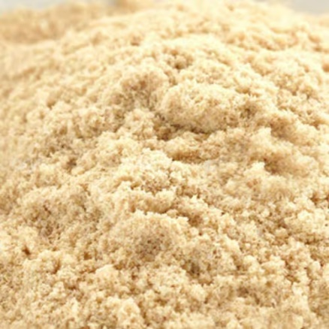
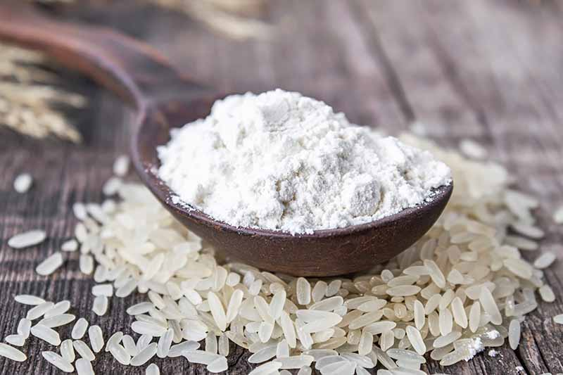
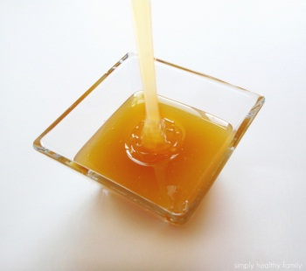
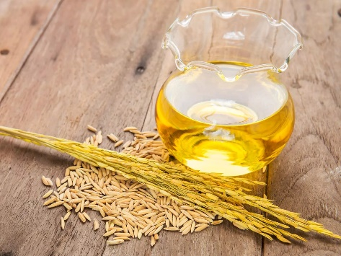
Rice Co-Products
Rice Flour
Ideal for gluten-free products
Good for dusting dough surfaces
Makes crispier coatings, does not readily absorb water
Rice Bran
Good source of dietary fiber
Rich in antioxidants – reduces risk of heart disease, certain cancers, & type II diabetes
Rice Syrup
Mild flavored sweet syrup
Substitute for sugar, honey, corn syrup, molasses, or maple syrup in recipes
Rice Bran Oil
Extracted from rice bran
Nut-like flavor, good shelf stability and ideal for frying
May help reduce cholesterol

Slide 21
For More Information
Visit ThinkRice.com
Contact Us
Cameron Jacobs, CAE
Sr. Director, Domestic Promotion
cjacobs@usarice.com
www.thinkrice.com

